Slide 1
Sean Hansen
Jon Comisky
A Transfer Learning Approach to Fine-grained Dog Breed Classification
Notes:
Under 10 min presentation
Things to cover:
Project Topic -> Jon
Project Goal -> Jon
Progress made
Steps taken to reach this point
Obtained data set -> Sean
Tried and failed multiple times to use the database
Setup local host -> Sean Hansen
Installed so many modules
Tested custom models on dataset & localhost -> Jon
Terrible accuracy
Moved to testing other people’s methods
Abandoned local host in favor of Colab Pro’s higher memory limit -> Sean Hansen
Got 2 of them to work
Discovering dog breed with machine learning -> Sean Hansen
Good accuracy >80% but fairly intricate
Don’t actually know how the model is performing under the hood
Time constraints of only getting it fully working on the 23rd.
Dog breed classifier with TensorFlow 2.0 -> Jon
Issues with overfitting
Using MobileNetV2 as Backbone model
Ideal for building on top of to change models, fine tune, etc.
Easy to modify to run experiments
Next Steps
Run on other pretrained models -> Sean
VGG-19, DenseNet-201, Xception, and Inception V3

Slide 2
Overview
Our project’s source code
The changes we made
Our pipeline
The training iterations we ran
The output of our tests
Our final model results

Slide 3
Source
https://github.com/nikhilroxtomar/Dog-Breed-Classifier-using-TF2.0/blob/master/train.py
Notes:
Our goal is to create a fine grained dog breed classifier that takes a static image and outputs around four of the top breeds that the AI believes the dog is. The feasibility of this goal has been coming into question due to the fact that getting a classifier to run at all was a difficult task.

Slide 4
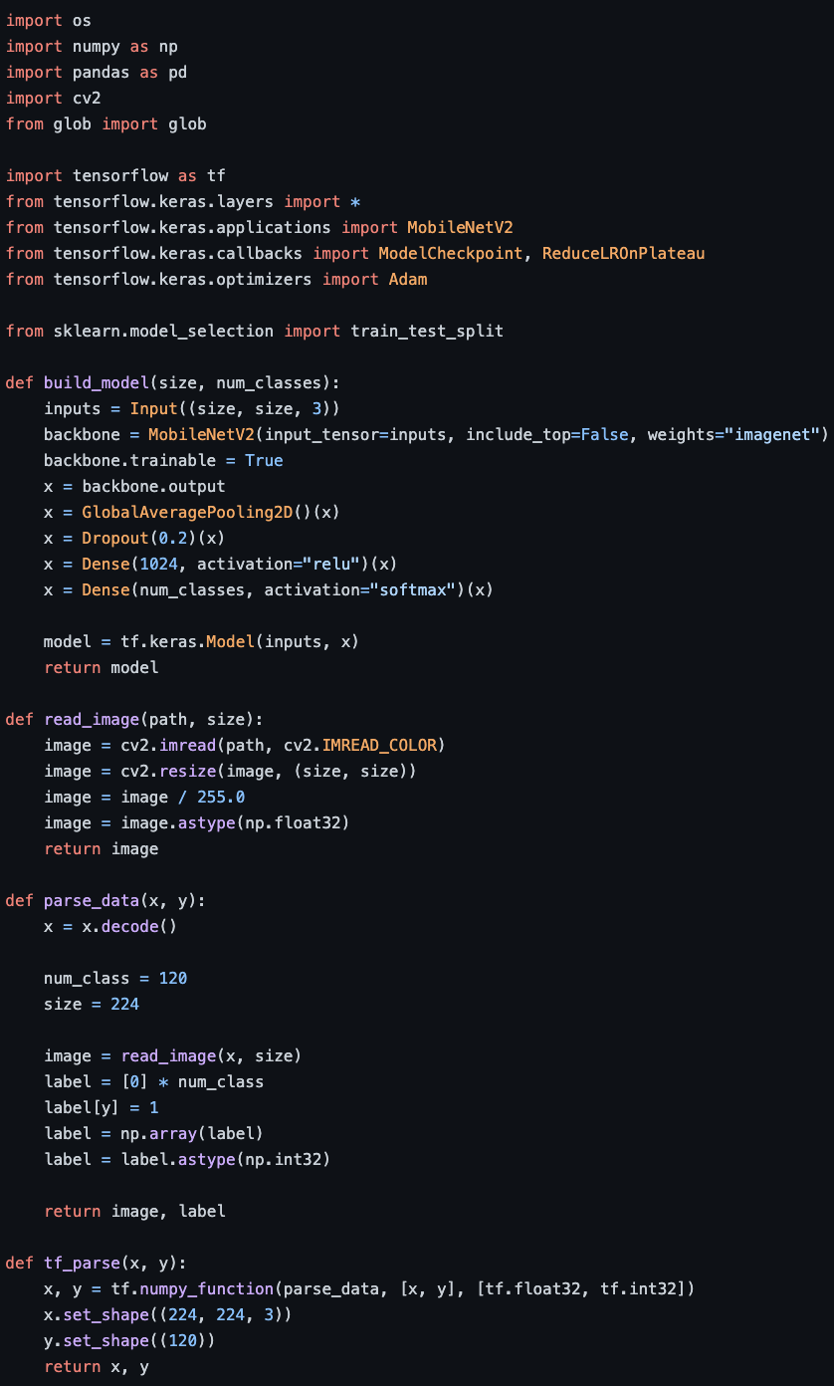
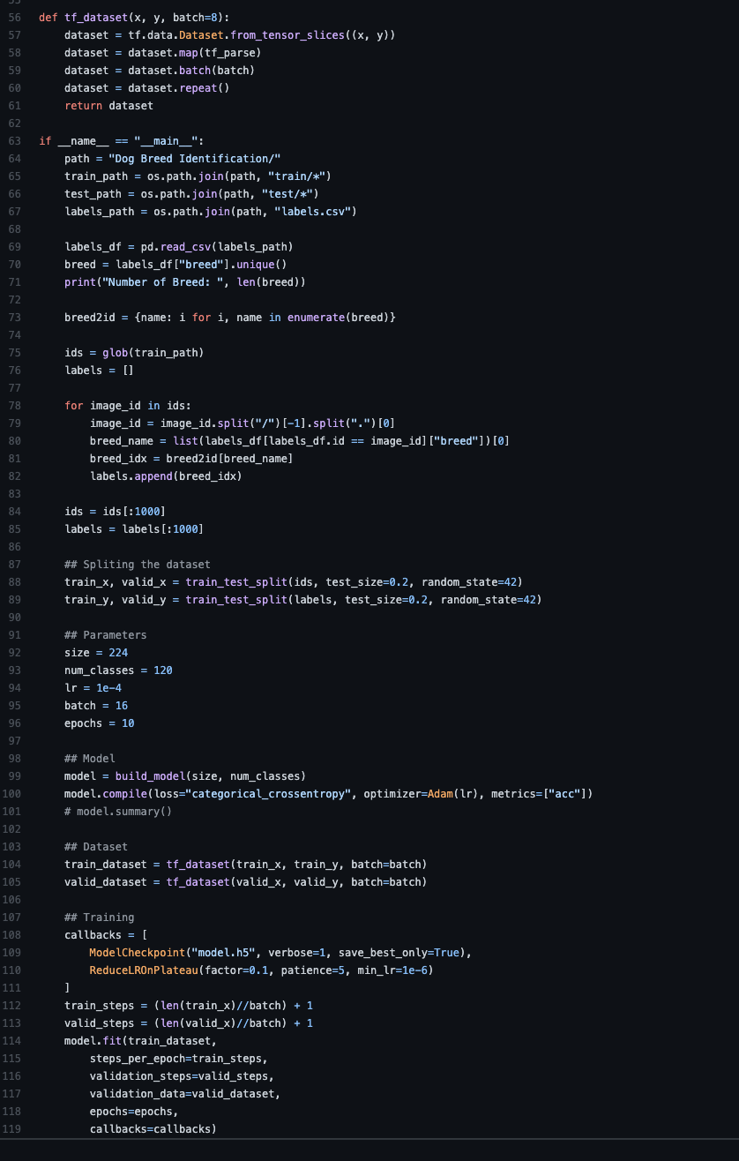
Training

Slide 5
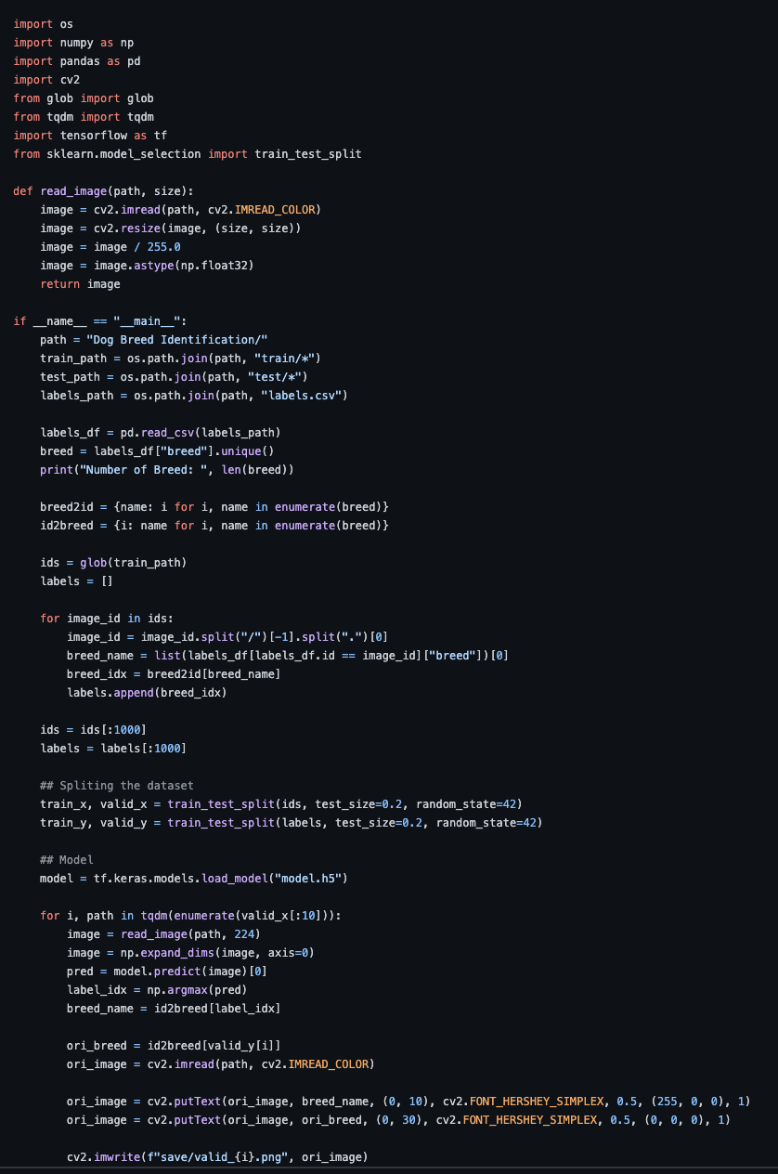
Testing

Slide 6
Our changes
Our repository

Slide 7
Pipelines
ResNet50
Xception
DenseNet201
VGG19
Dropout(0.25)(x)
BatchNormalization()(x)
Dropout(0.25)(x)
GlobalAveragePooling2D()(x)
Dropout(0.25)(x)
Dense(1024, activity_regularizer=regularizers.l2())(x)
Dropout(0.25)(x)
Dense(num_classes, activation="softmax", activity_regularizer=regularizers.l2())(x)
Flatten()(x)

Slide 8
Data Split
90%
18,522
10%
2,058
Train
Validation
Test

Slide 9
Train
Lower LR
Fine Tune
20 Epochs; No Data Augmentation;
Image-Net; LR = 1e-1
20 Epochs; No Data Augmentation;
Train Callback; LR = 1e-2
20 Epochs; No Data Augmentation;
Lower LR Callback; LR = 1e-2

Slide 10
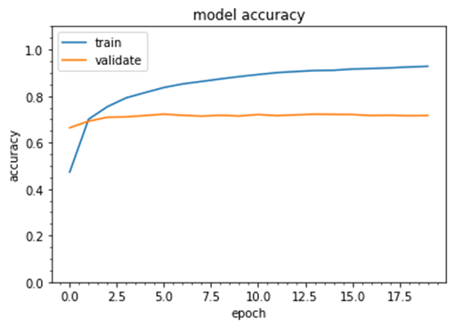
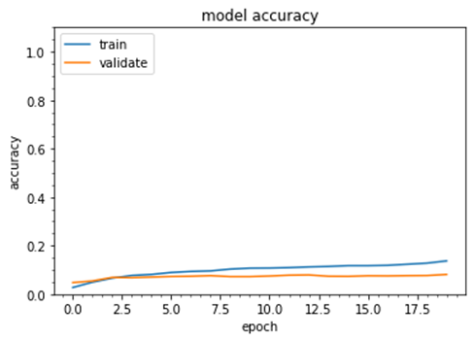
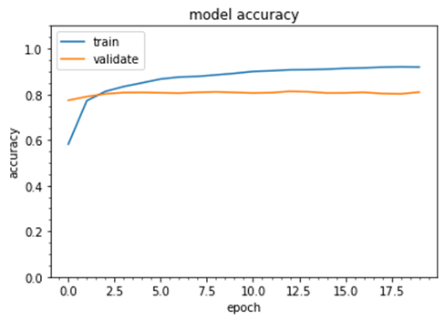
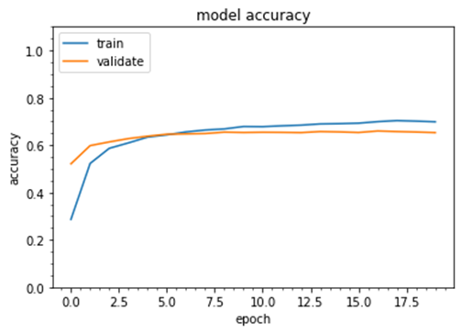
Training Accuracy
ResNet50
Xception
DenseNet201
VGG19
Train:
92.79% -> 95.30%
Validate:
71.62% -> 72.50%
Train:
13.70% -> 8.11%
Validate:
14.31% -> 8.07%
Train:
91.92% -> 94.05%
Validate:
80.95% -> 80.71%
Train:
69.87% -> 72.44%
Validate:
65.31% -> 65.31%

Slide 11
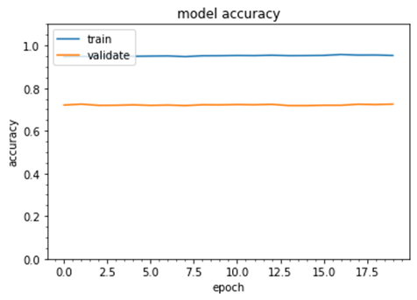
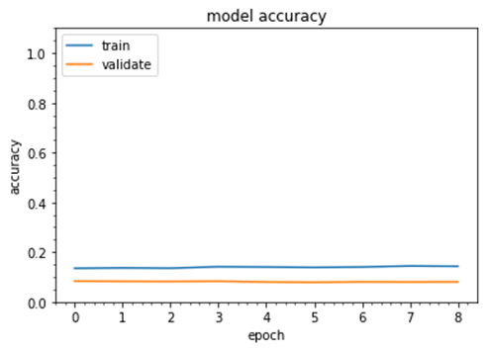
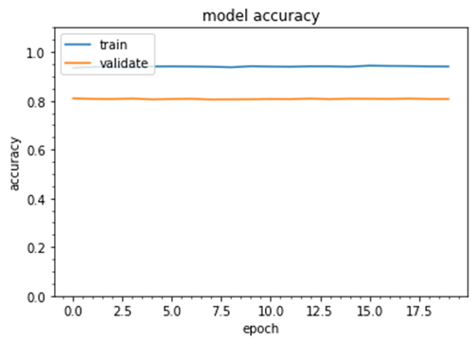
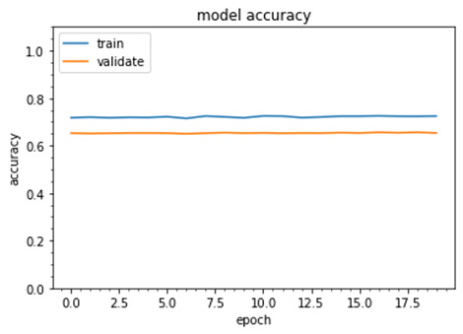
Lower LR Accuracy
ResNet50
Xception
DenseNet201
VGG19
Train:
92.79% -> 95.30%
Validate:
71.62% -> 72.50%
Train:
13.70% -> 8.11%
Validate:
14.31% -> 8.07%
Train:
91.92% -> 94.05%
Validate:
80.95% -> 80.71%
Train:
69.87% -> 72.44%
Validate:
65.31% -> 65.31%

Slide 12
Overall Accuracy
ResNet50
Xception
DenseNet201
VGG19
Train:
92.79% -> 95.30%
Validate:
71.62% -> 72.50%
Train:
13.70% -> 8.11%
Validate:
14.31% -> 8.07%
Train:
91.92% -> 94.05%
Validate:
80.95% -> 80.71%
Train:
69.87% -> 72.44%
Validate:
65.31% -> 65.31%

Slide 13
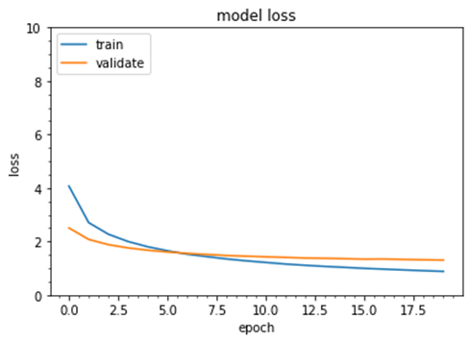
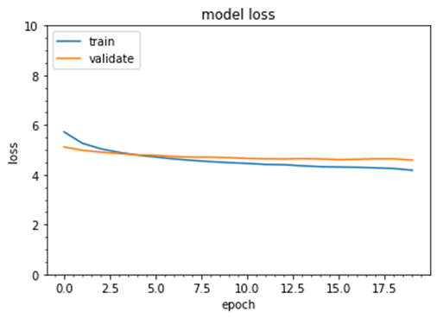

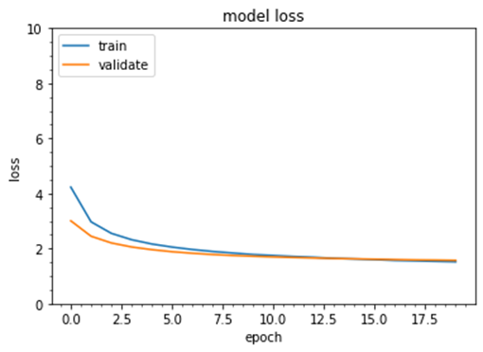
Overall Loss
ResNet50
Xception
DenseNet201
VGG19
Train: 0.8832
Validate: 1.3031
Train: 4.1828
Validate: 4.5909
Train: 0.7611
Validate: 0.9486
Train: 1.5191
Validate: 1.5720

Slide 14
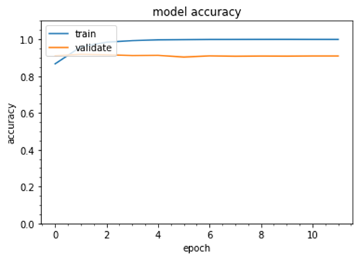
Fine Tune
99.9%
90.9%
98.0%
Train
Validate
Test
Loss stopped improving after 12 epochs

Slide 15
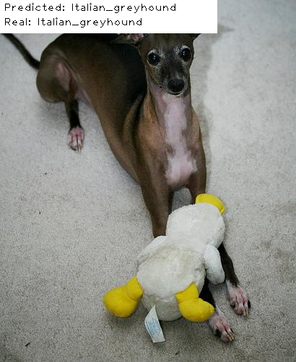
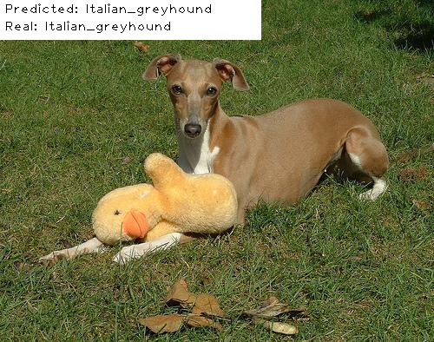
Results

Slide 16
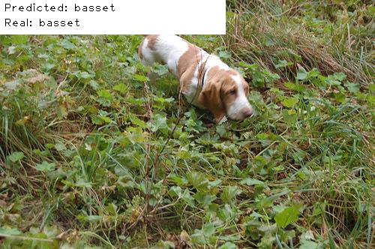
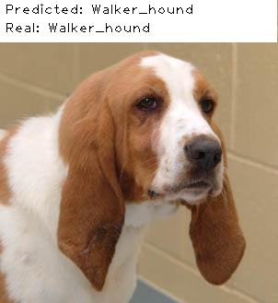
Results

Slide 17
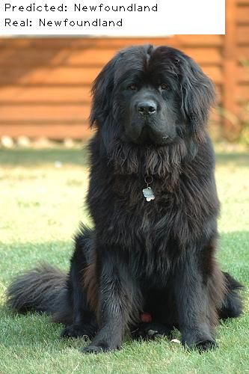
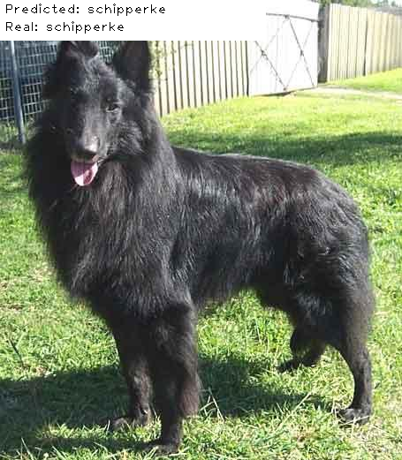
Results

Slide 18
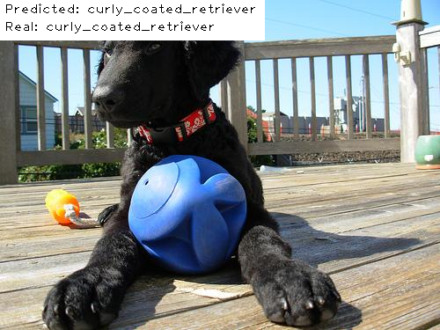
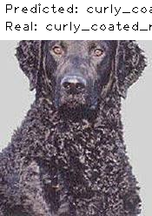
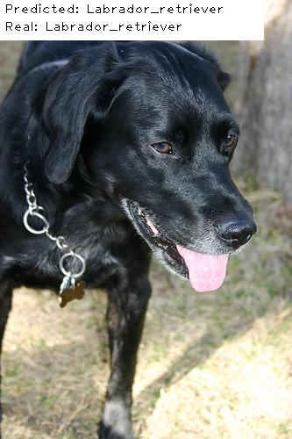
Results

Slide 19
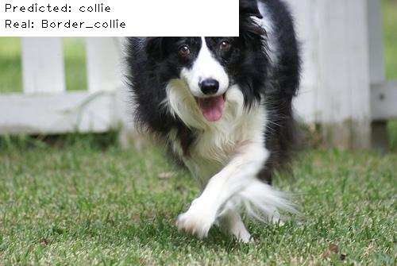
Results

Slide 20
Conclusions
More Training != Better Results
DenseNet201 = Best Model
Transfer Learning
Fine Tuning = Better Results
Testing Results > Validation

